Slide 1

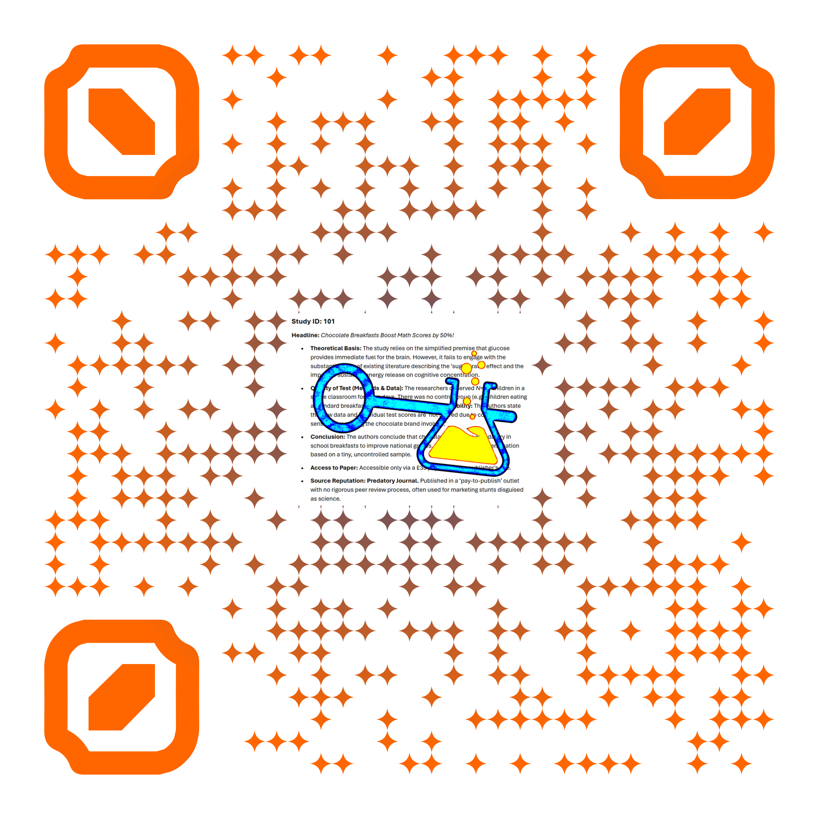

Scan the code
Unlock the Lab

Slide 2
Scan the code
Unlock the Lab

Slide 3
Scan the code
Unlock the Lab

Slide 4
Scan the code
Unlock the Lab

Slide 5
Scan the code
Unlock the Lab

Slide 6
Scan the code
Unlock the Lab

Slide 7
Scan the code
Unlock the Lab

Slide 8
Scan the code
Unlock the Lab

Slide 9
Scan the code
Unlock the Lab

